Slide 1
Unit 4 Lesson 0 - Introduction to Compound Data
Do now
How many fields make up email data?
For example a subject is a field.
Notes:
In examples like this, we see the need for structured data: a single datum actually consists of many pieces. The number of pieces is fixed, but may be of different kinds (some might be numbers, some strings, some images, and different types may be mixed together in that one datum). Some might even be other structured data: for instance, a date usually has at least three parts, the day, month, and year. The parts of a structured datum are called itsfields.

Slide 2
Unit 4 Lesson 0 - Introduction to Compound Data
How many fields make up a song in iTunes?
For example a title is a field.
Notes:
In examples like this, we see the need for structured data: a single datum actually consists of many pieces. The number of pieces is fixed, but may be of different kinds (some might be numbers, some strings, some images, and different types may be mixed together in that one datum). Some might even be other structured data: for instance, a date usually has at least three parts, the day, month, and year. The parts of a structured datum are called itsfields.

Slide 3
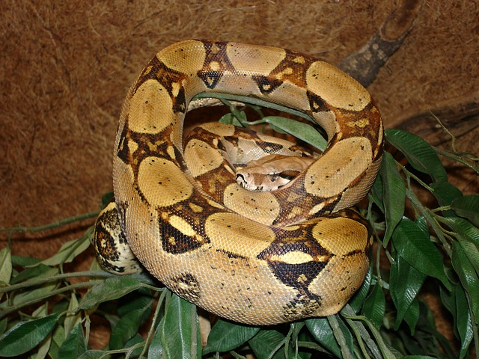
a Boa
is a boa(string, number, string)
data Boa:
boa(name :: String,
length :: Number,
eats :: String)
end

Slide 4
a boa is a boa(string, number, string)
data Boa:
boa(name :: String, length :: Number, eats :: String)
end
B1 = boa("Slinky", 30, "pets")
B2 = boa("Slim", 50, "homework")

Slide 5
data definitions also create functions
data Boa:
boa(name :: String, length :: Number, eats :: String)
end
# Boa constructor function
# boa : String Number String -> Boa
B1 = boa("Slinky", 30, "pets")

Slide 6
data definitions also create functions
data Boa:
boa(name :: String, length :: Number, eats :: String)
end
# Boa accessor functions
# nameOfBoa.name : Boa -> String
# nameOfBoa.length : Boa -> Number
# nameOfBoa.eats : Boa -> String
B2 = boa("Slim", 50, "homework")
B2.name -> “Slim”
B2.length -> 50
B2.eats -> “homework”

Slide 7
data definitions also create functions
data Boa:
boa(name :: String, length :: Number, eats :: String)
end
# Boa predicate function
# is-boa: Data -> Boolean
B2 = boa("Slim", 50, "homework")
is-boa(B2) -> true

Slide 8
write 3 examples of boa-fit-cage
fun boa-fit-cage(aboa :: Boa, limit :: Number) -> Boolean:
doc: “consumes a boa and a limit and produces true if the boa will fit inside the cage, false if it will not”

Slide 9
write 3 examples of boa-fit-cage
fun boa-fit-cage(aboa :: Boa, limit :: Number) -> Boolean:
doc: “consumes a boa and a limit and produces true if the boa will fit inside the cage, false if it will not”
aboa.length <= limit
end
check:
boa-fit-cage(B2), 10) is false
boa-fit-cage(boa("Slinky", 30, "pets"), 30) is true
boa-fit-cage(boa(“Slinky”, 30, “pets”), 55) is true
end

Slide 10
# a dillo is a dillo(number, boolean)
data Armadillo:
| dillo(length :: Number, dead :: Boolean)
end
D1 = dillo(20, true)
D2 = dillo(5, false)

Slide 11
# hit-with-truck: dillo -> dillo
# return dead dillo one unit longer than given dillo
Define the rest of this function using the design recipe. Write a function header, examples, and a function body.

Slide 12
# hit-with-truck: dillo -> dillo
# return dead dillo one unit longer than given dillo
Define the rest of this function using the design recipe. Write a function header, examples, and a function body.

Slide 13
# a tiger is a tiger(string, number, product)
# a product is a product(string, string)
data Product:
| product(item :: String, company :: String)
end
# a tiger is a tiger(string, number, product)
data Tiger:
| tiger(name :: String, length :: Number, sells :: Product)
end

Slide 14
# a tiger is a tiger(string, number, product)
Design a function called sells-gas, which returns true if a given tiger sells gas

